Slide 1
A Novel Application of Computer Vision and Machine Learning for Three-Dimensional Reconstruction of Lung Anatomy and Pathology
Done By: Bardh Rushiti
Mentored By: Dr. Thomas Kinsman
RIT, 2023

Slide 2
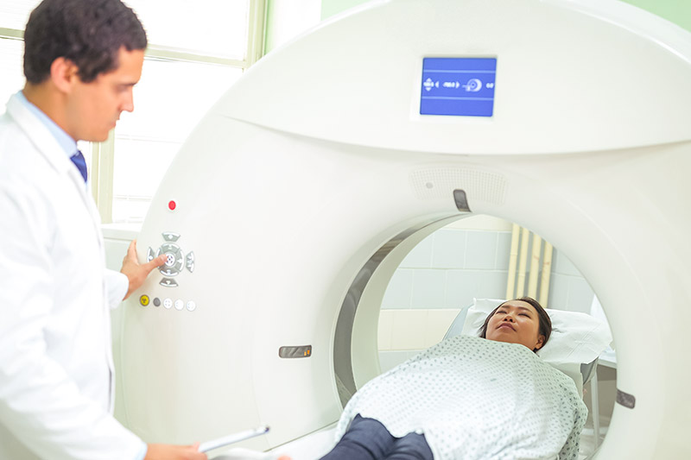
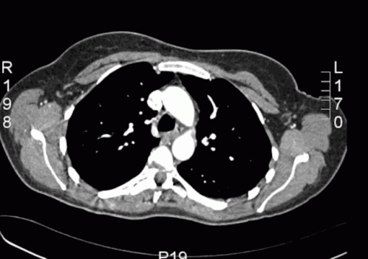
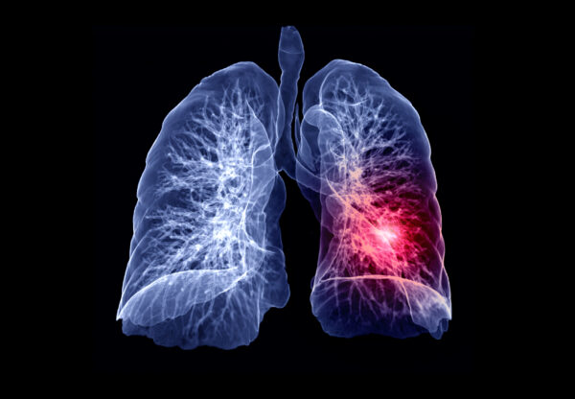

Overview
Utilize advanced computer vision and machine learning techniques for 3D reconstruction of lungs, airways, and potential lung nodules.

Slide 3
Overview
Nodule Detection, Segmentation, and 3D Reconstruction
Airways Segmentation and 3D Reconstruction
Lung Segmentation and 3D Reconstruction

Slide 4
Motivation
Early detection is crucial for improving patient outcomes in lung cancer
Current methods are manual and time-consuming, leading to low accuracy and efficiency
Improve preoperative planning and simplify complex procedure by enhancing the surgeon’s knowledge of the patient’s specific anatomy

Slide 5
Objective
To analyze nodule size, shape, location, and proximity to airways for signs of malignancy.
To improve the accuracy and efficiency of lung nodule detection through image pre-processing, feature extraction, and model training and evaluation.
To potentially improve the diagnostic capabilities of oncologists and patient outcomes by providing a more accurate and efficient method for lung nodule detection and lung and airway reconstruction.

Slide 6
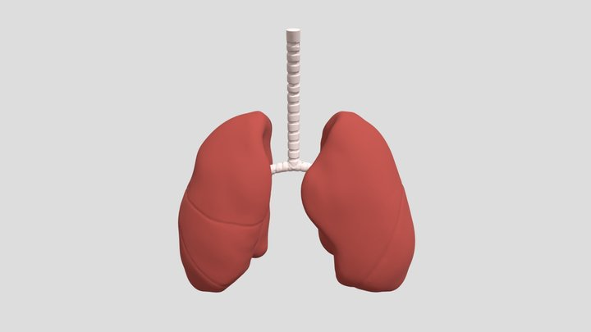
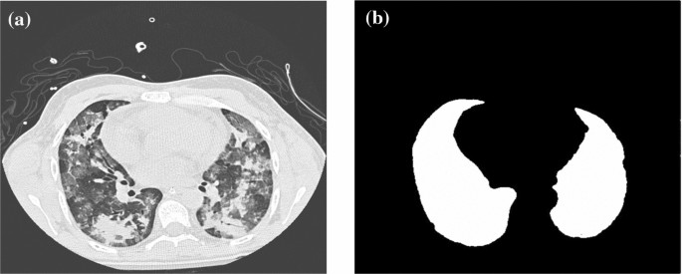
Background - Lungs
[2] segments lungs using classical vision techniques like thresholding, morphological operation, region growing.
[3] segments lungs by using intensity and gradient features.
[4] uses CNN to segment out lungs region from non-lung regions.
[1] constructs the 3D model by using different angular positions of CT scan.

Slide 7
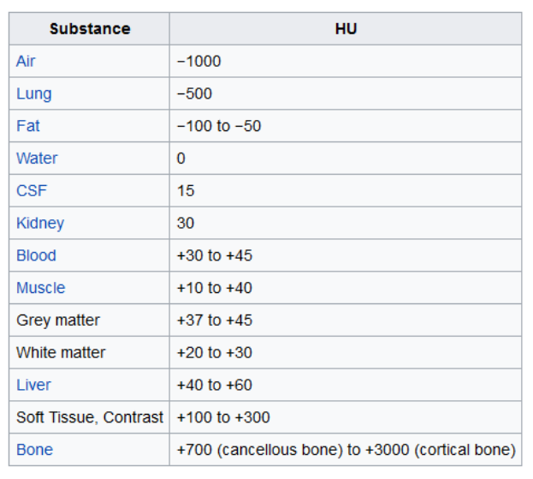
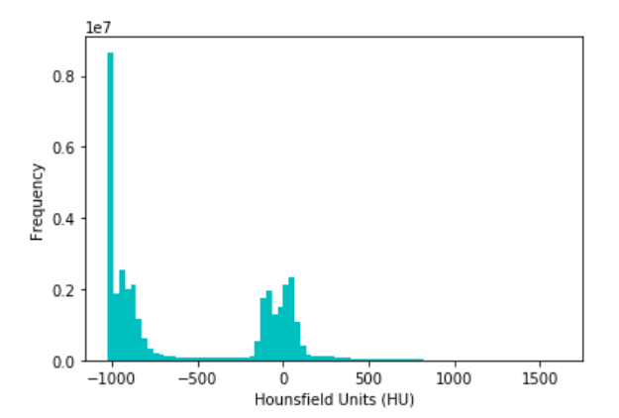
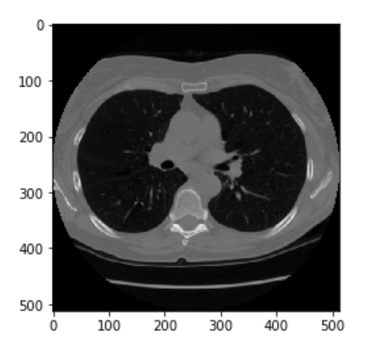
Converting The Pixel Values to Hounsfield Units
CT measured in Hounsfield Unit (HU) → measure of radiodensity
CT scanners are carefully calibrated to accurately measure Hounsfield Units
The returned values are not in Hounsfield Units by default
Rescale slope and added the intercept, which are stored in the scan metadata

Slide 8
Resampling to an Isomorphic Resolution
Pixel spacing of [2.5, 0.5, 0.5] means distance between slices is 2.5mm
Pixel spacing of [1.5, 0.725, 0.725] is problematic for automatic analysis
It's important to resample the dataset to isotropic resolution
Resampling will be done to 1mm x 1mm x 1mm

Slide 9
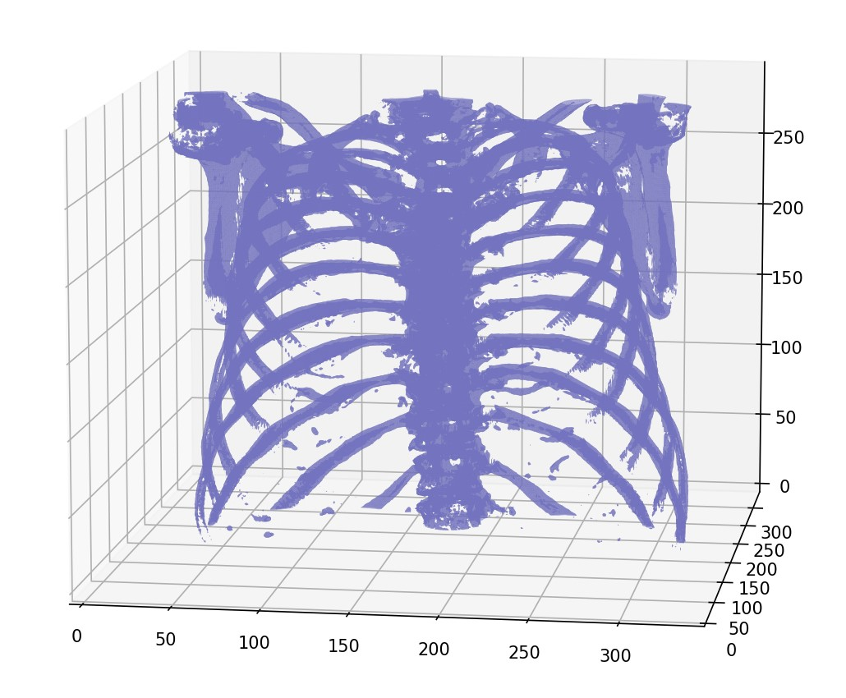
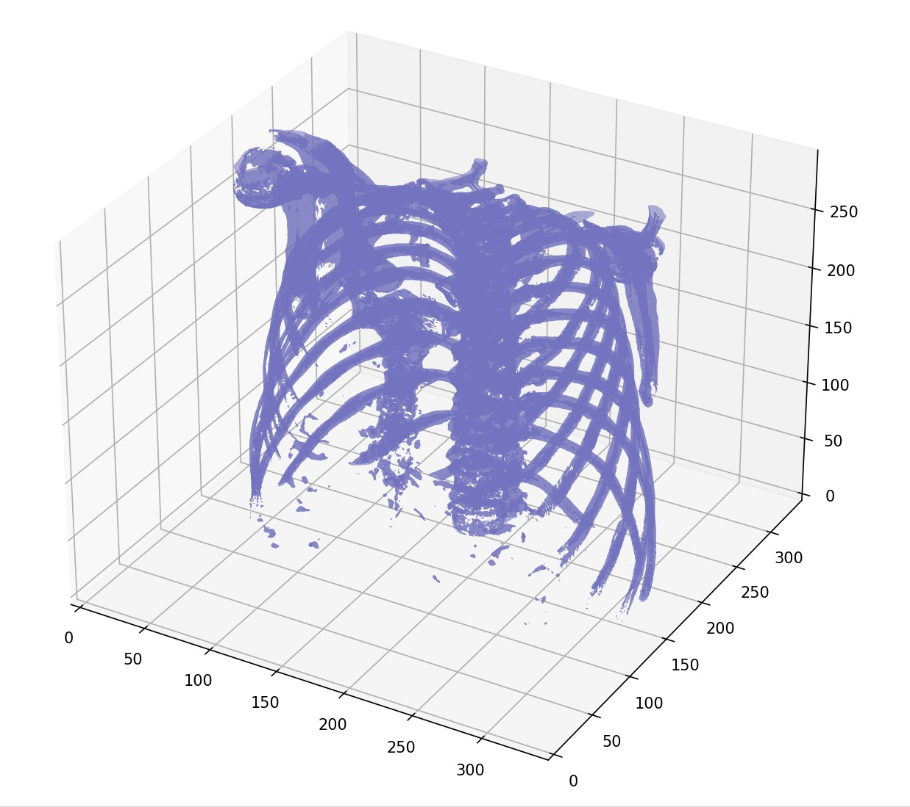
3D Plotting
Useful for understanding structure and orientation of scans
Important for lungs due to complex shape difficult to interpret in 2D
Use Poly3DCollection function from mpl_toolkits.mplot3d.art3d library

Slide 10
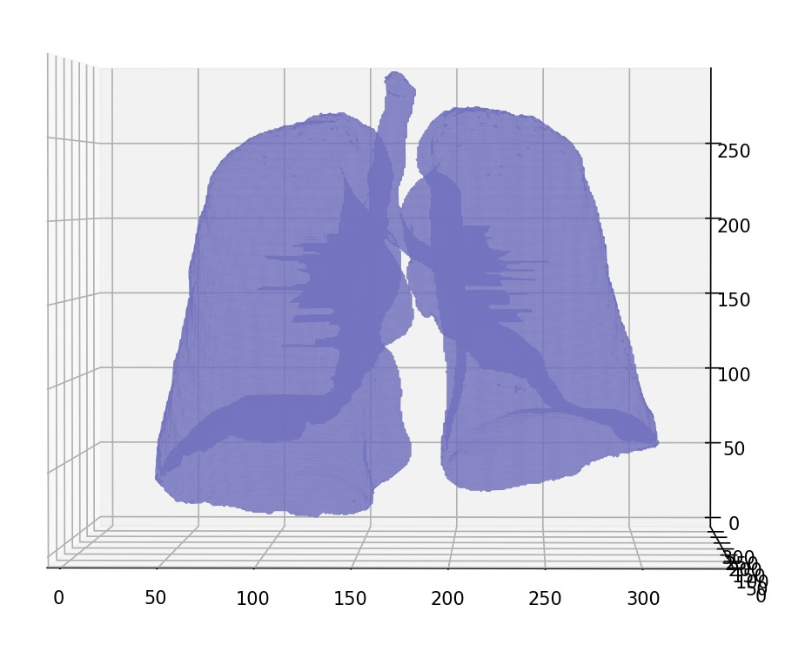
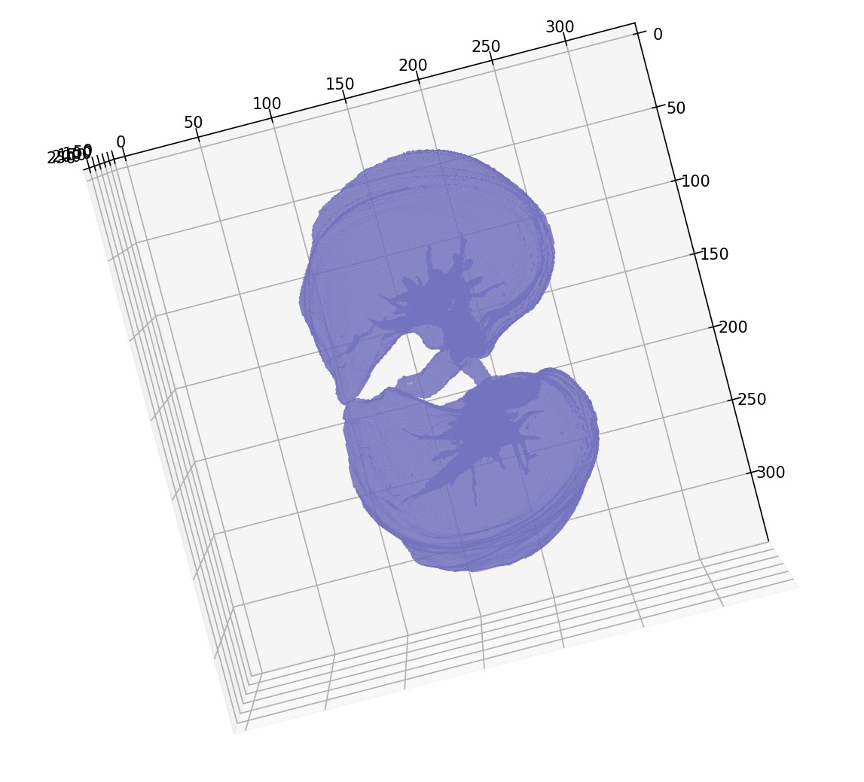
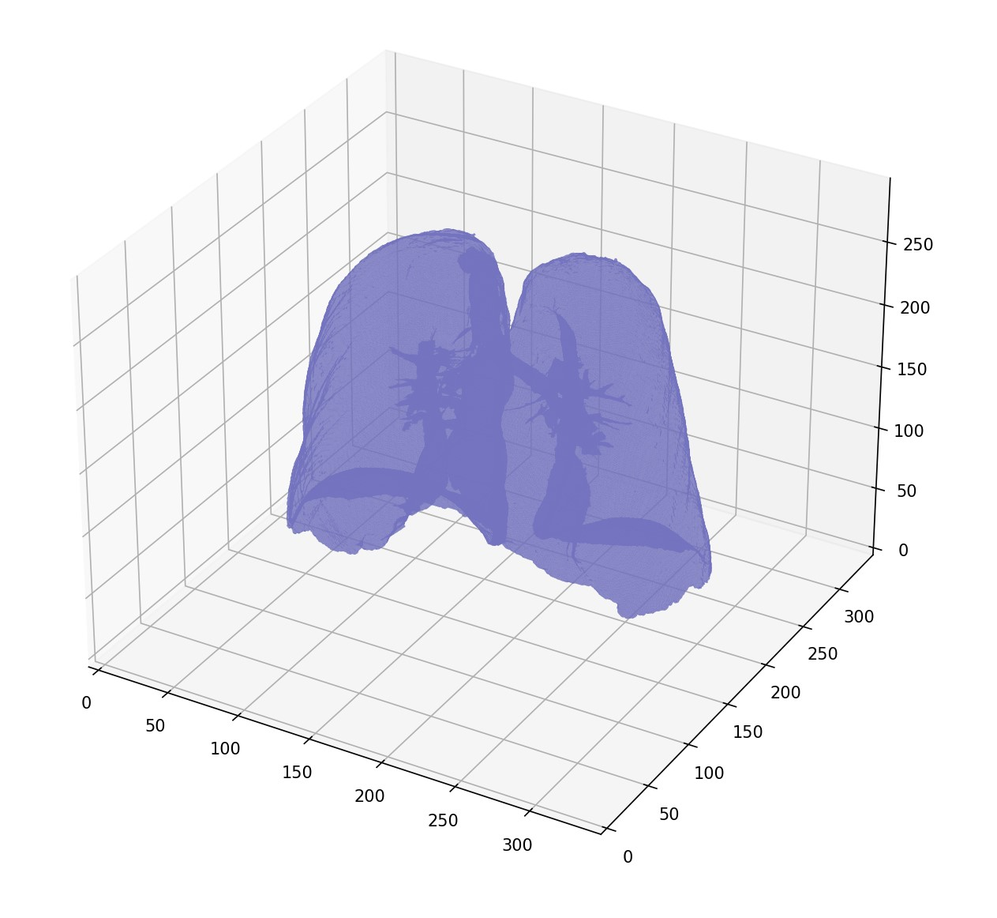
Lung Segmentation and 3D Reconstruction
Threshold the image to separate air from tissue
Use connected component analysis algorithm to find connected regions
Keep largest connected component to select region corresponding to the lung

Slide 11
Thank You!

Slide 12
Useful References
"Three-dimensional pulmonary imaging by computed tomography," by Sundaram et al., Radiology, 1983
"Semi-automated segmentation of lung regions in CT images," by Yan et al., Medical Image Analysis, 2005
"Automated lung segmentation in CT images using a supervised classification approach," by Castillo et al., Medical Image Analysis, 2008
"Pulmonary airway tree extraction and morphometric analysis from CT images," by Henschke et al., Radiology, 2003
"Automatic Segmentation of Airway Tree Structures in CT Images" by Willems et al. (2010)
"A Hybrid Model for Airway Segmentation in CT Images" by Ge et al. (2010)
"Automatic Airway Tree Segmentation using 3D Convolutional Neural Networks" by Shuo Han et al. (2018)
"Computer-aided detection of lung nodules on CT scans: a comparative study" by Armato et al. (2011)
"Deep convolutional neural networks for computer-aided detection: CNN architectures, dataset characteristics and transfer learning" by Zhang et al. (2017)
"NoduleNet: A Deep Learning Framework for Automated Pulmonary Nodule Detection and Classification on CT Images" by Lee et al. (2019)

Slide 13
Tetrahedron – 3D volume
Change colors
References (Write full references, author of the github repo, and when did you access that)
Start thinking in LaTex
Some pseudo code of the code

Slide 14
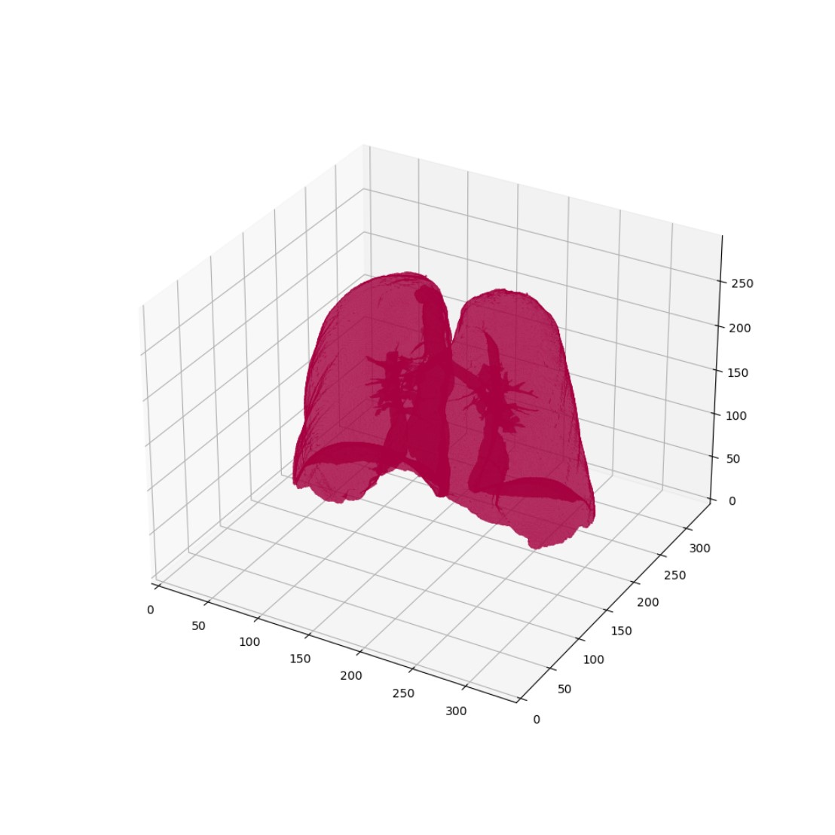

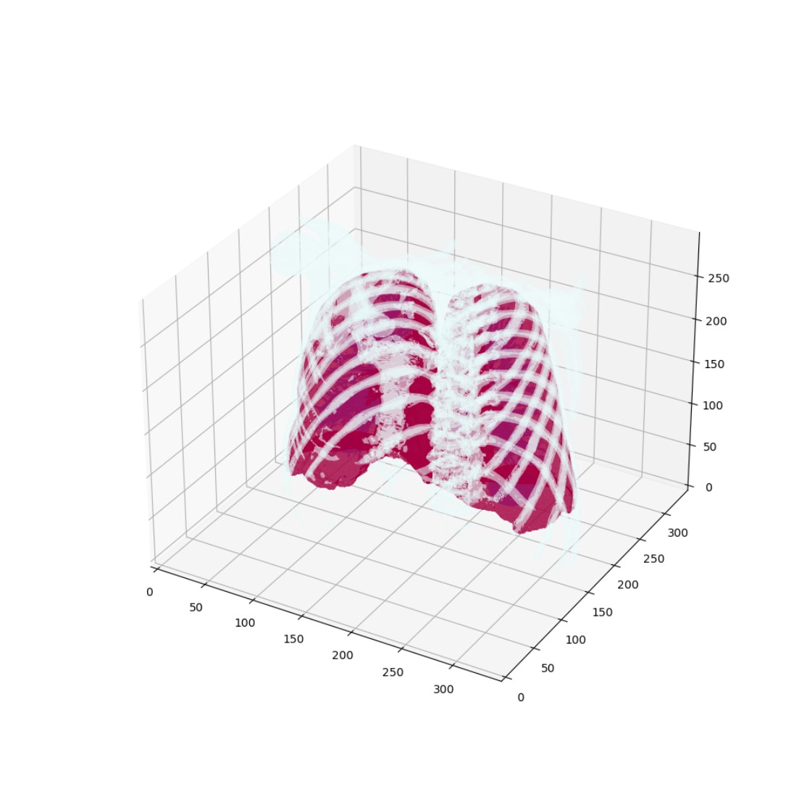

Slide 15
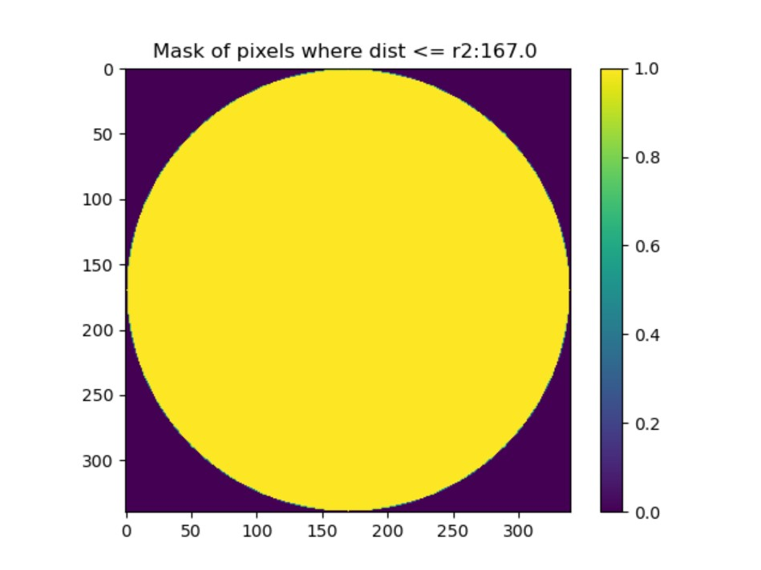
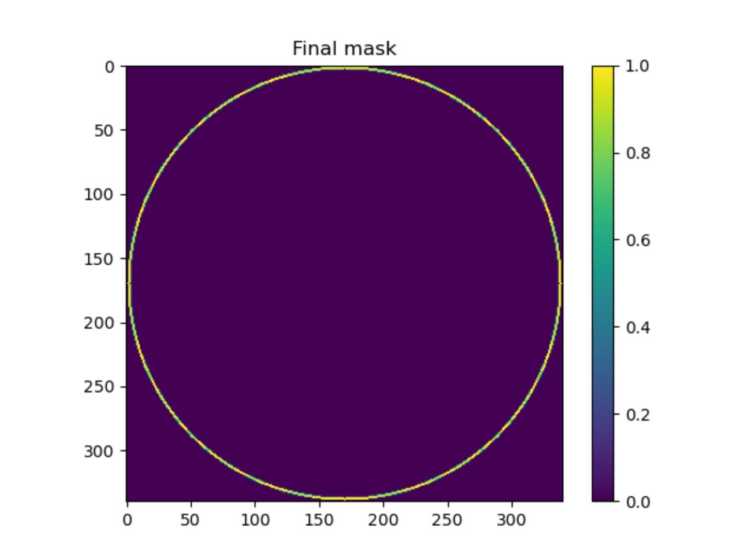
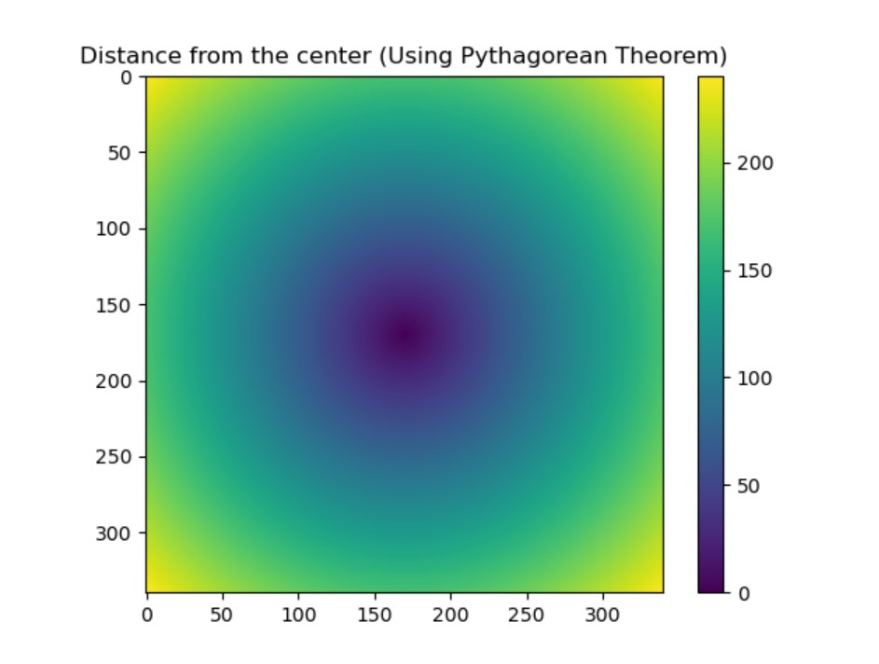
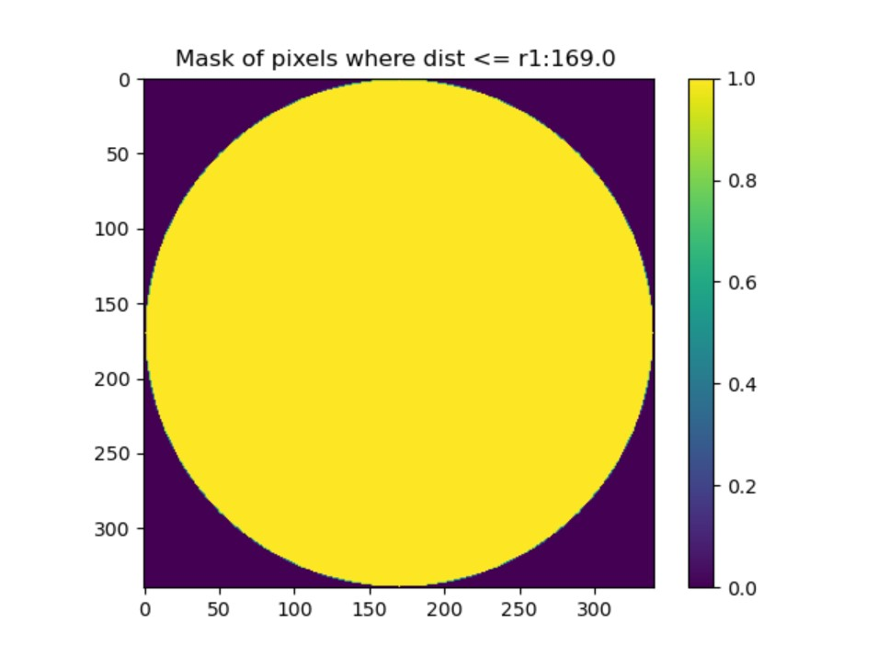

Slide 16
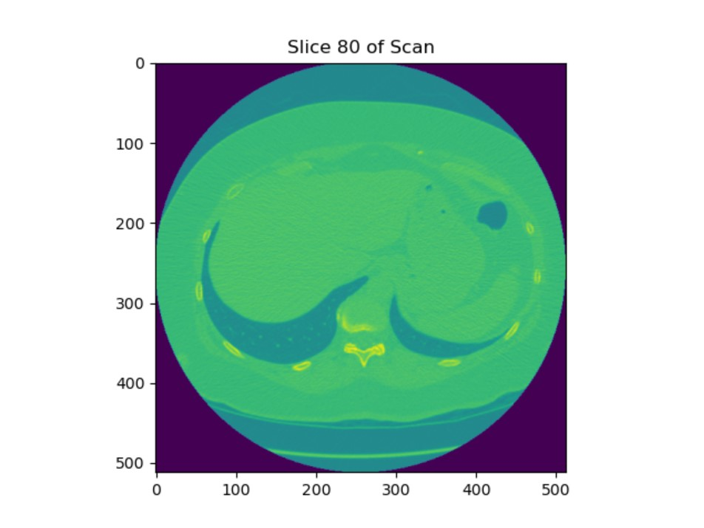
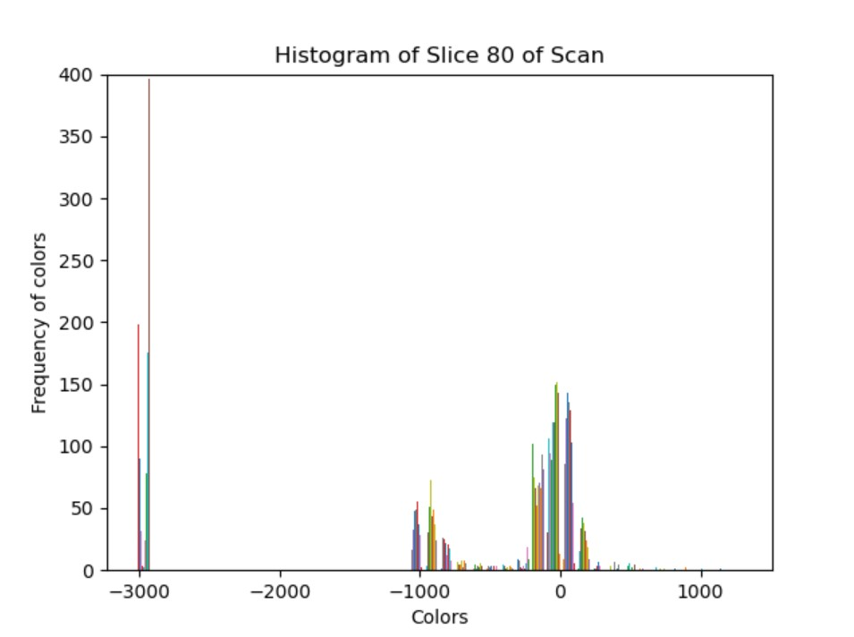
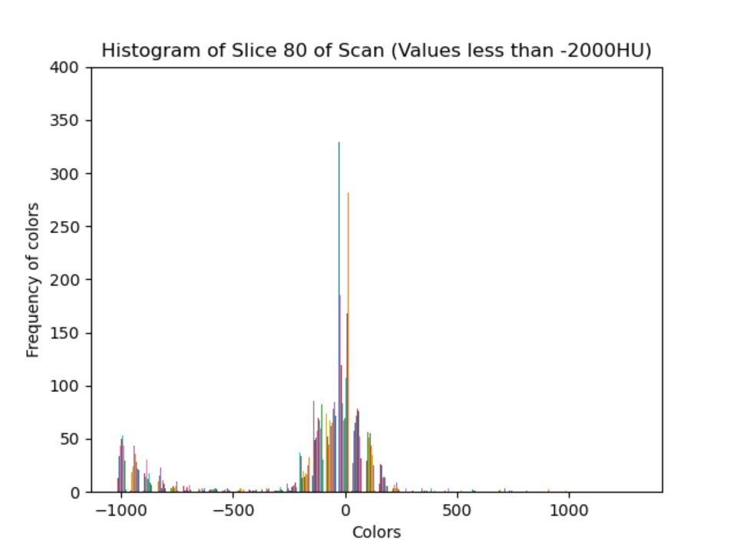
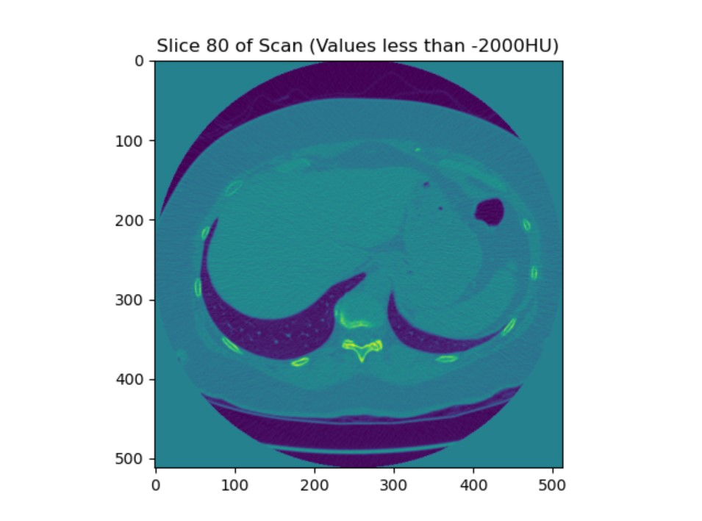

Slide 17
Pseudo Code

Slide 18
Explore how it faster: CUDA/ GPU:
Run it on GPU
Vision/ Graphics models
(First) Lower resolution image
(Later) Higher resolution image
Standard Views → precompute

